Slide 1

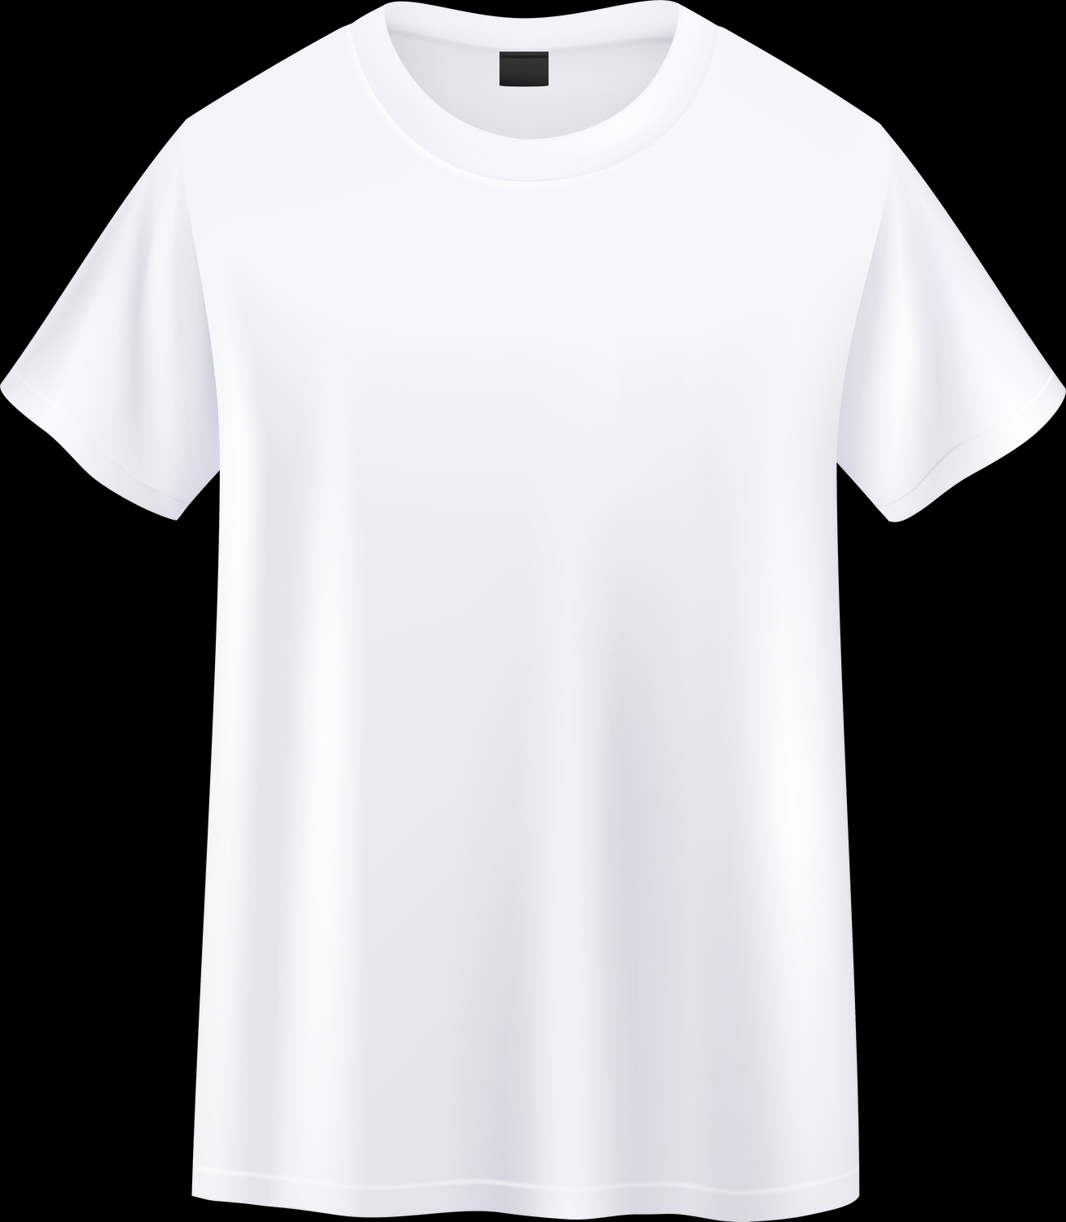
“FE ELSALEM”
Fake products recognition System
Team Members
Marwan Ehab Hassan
Mina Samir
Adham El Sayed
Abdallah Magdy
SUPERVISED BY
Aya Hesham

Slide 2
“FE ELSALEM”
Fake products recognition System
Topic Outline
Problem Stament
Idea Overview
Data Collection
Data Annotations
Data Splitting
Model Selection
YOLOV8
Test Samples

Slide 3

“FE ELSALEM”
Fake products recognition System
Part one
Problem Stament
Counterfeit products are increasingly prevalent, threatening consumer safety and brand integrity, and causing financial losses. There is a need for a reliable system to accurately identify and prevent the distribution of these fake goods.

Slide 4

“FE ELSALEM”
Part Two
Fake products recognition System
Idea Overview
Quick Explanation
"FE ELSLEM" is a fake products recognition system that uses
image recognition and machine learning to identify counterfeit goods.
Users can scan products to verify authenticity,
and the system analyzes visual and data patterns to detect fakes,
providing quick results and alerts to prevent the spread of counterfeit products.

Slide 5
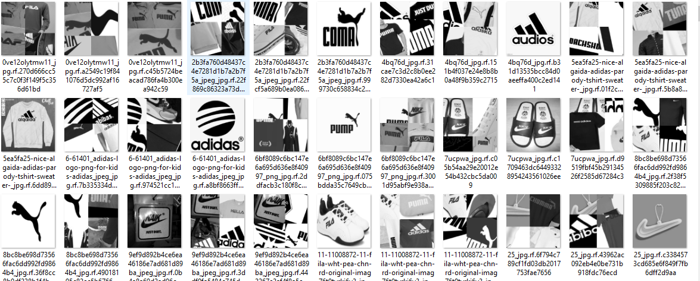
“FE ELSALEM”
Part Three
Fake products recognition System
Data Collection
We collected 800 images of various products, including both genuine and counterfeit items, from online marketplaces, retail stores, and manufacturer databases. This diverse dataset will train and test our system's machine learning models to accurately identify fake products.

Slide 6
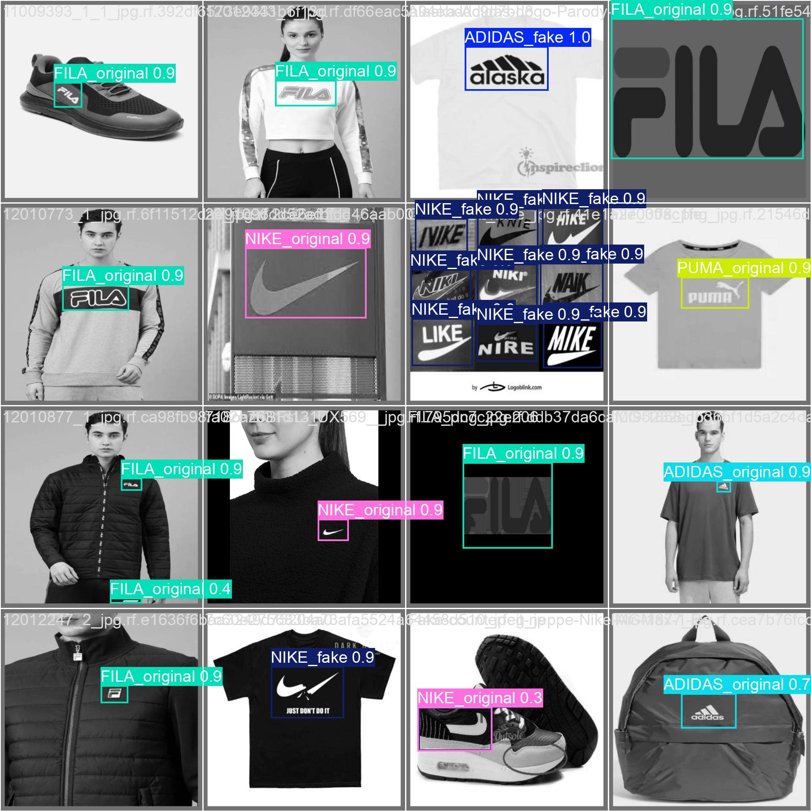
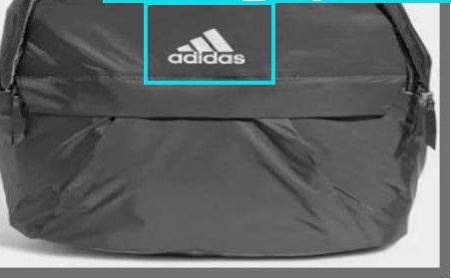
“FE ELSALEM”
Part Four
Fake products recognition System
Data Annotations
Each of the 800 images in our dataset has been meticulously annotated to distinguish between genuine and counterfeit products. Annotations include labels indicating authenticity, product category, and specific features to aid in recognition. This detailed labeling enhances the accuracy of our machine learning models by providing them with precise data to learn from, ensuring the system can effectively identify fake products.

Slide 7

“FE ELSALEM”
Part Five
Fake products recognition System
Data Splitting
The dataset of 800 images is divided into 700 for training, 50 for testing, and 50 for validation. This split ensures effective model training and accurate performance evaluation.

Slide 8

“FE ELSALEM”
Part Six
Fake products recognition System
Model Selection
For the "FE ELSLEM" system, we selected the YOLOv8 model due to its state-of-the-art performance in image recognition tasks. YOLOv8 is known for its speed and accuracy in detecting objects and identifying patterns, making it ideal for distinguishing between genuine and counterfeit products.

Slide 9
“FE ELSALEM”
Part Seven
Fake products recognition System
YOLOV8
What is YOLOv8?
A state-of-the-art object detection model.
Known for its speed and real-time processing capabilities.
Provides high accuracy in detecting and classifying objects in images.

Slide 10
“FE ELSALEM”
Part Seven
Fake products recognition System
YOLOV8
Why We Chose YOLOv8:
Efficiency: Fast processing allows for real-time analysis of products.
Accuracy: High precision in distinguishing genuine products from counterfeits.
Robustness: Capable of handling complex scenes and diverse datasets effectively.

Slide 11
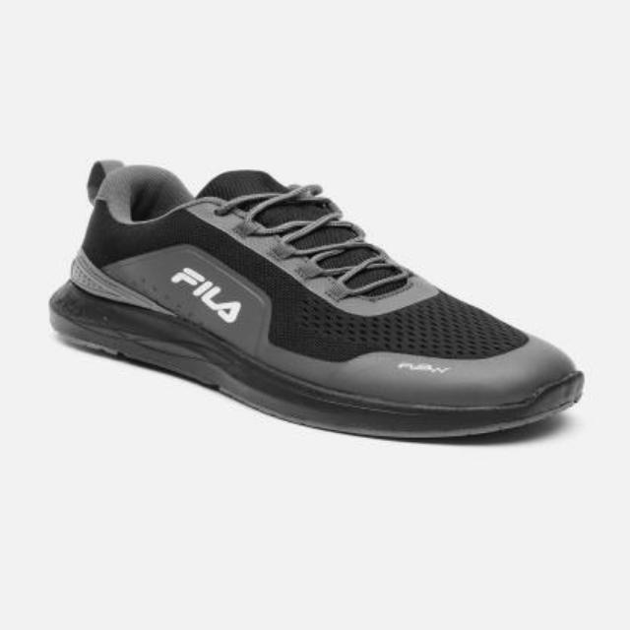
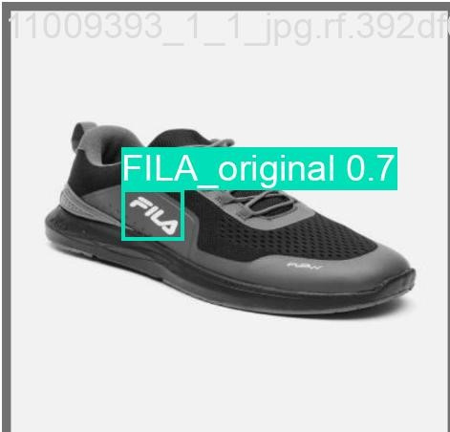
“FE ELSALEM”
Part Eight
Fake products recognition System
Test Samples

Slide 12

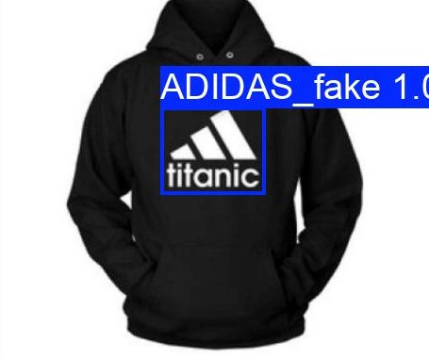
“FE ELSALEM”
Part Eight
Fake products recognition System
Test Samples

Slide 13
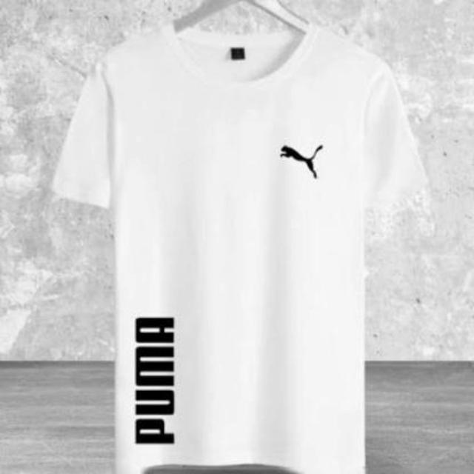
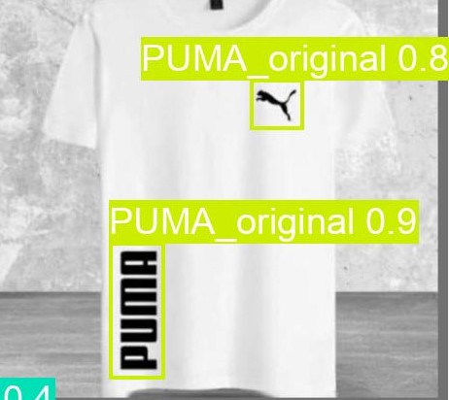
“FE ELSALEM”
Part Eight
Fake products recognition System
Test Samples

Slide 14
“FE ELSALEM”
Fake products recognition System
Future Work
Data Expansion
Deployment
Mobile Application
Features Increase
Marketing & Awareness

Slide 15


“FE ELSALEM”
Fake products recognition System
SUPERVISED BY
Aya Hesham

